Slide 1
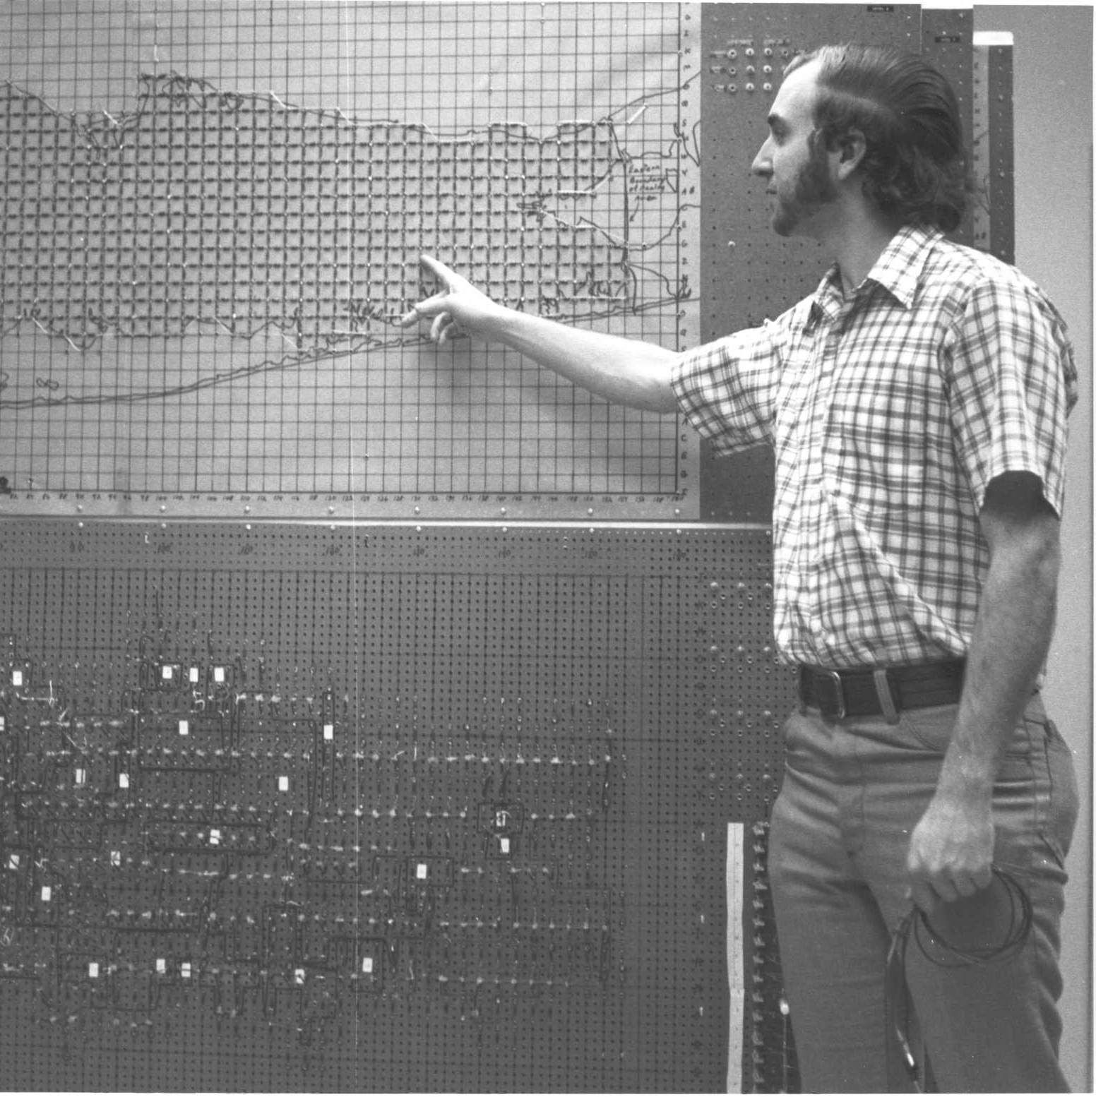
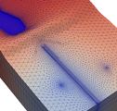
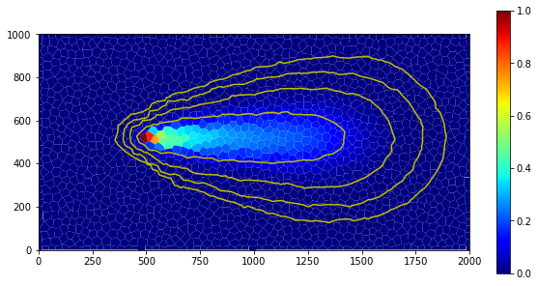
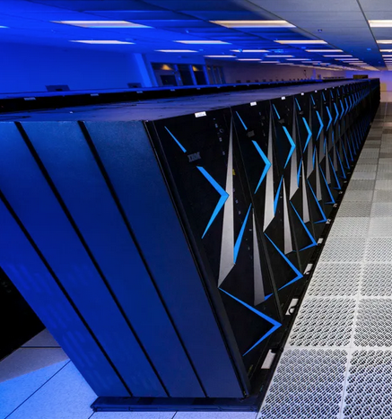


Status and Future Directions
Parallel MODFLOW Training Class, December 1st, 2023, Deltares, NL
Notes:
Why parallel?
Different forms of parallelism, which one for MODFLOW 6?
Theoretical expectations on performance?

Slide 2
Status Parallel MODFLOW 6
Capabilities:
Groundwater Flow (GWF) ✓
MVR 
BUY ✓
VSC 
Groundwater Transport (GWT) ✓
User experience related:
Load balance
User specified 
Feedback from run 
Improve output readability 
More performance gain 
Bring IMS preconditioner to use in parallel simulations (MILU) 
Workflow:
ModelSplitter
GWF ✓
GWT ✓
Splitting HFBs 
Split coupled models 
Other tools:
Merge parallel output data 
Other other tools?

Slide 3

How are you planning to use parallel MF6?
What types of models?
Compute infrastructure?
Are you comfortable with using WSL to run on Windows?

Slide 4
What should we improve?

Slide 5
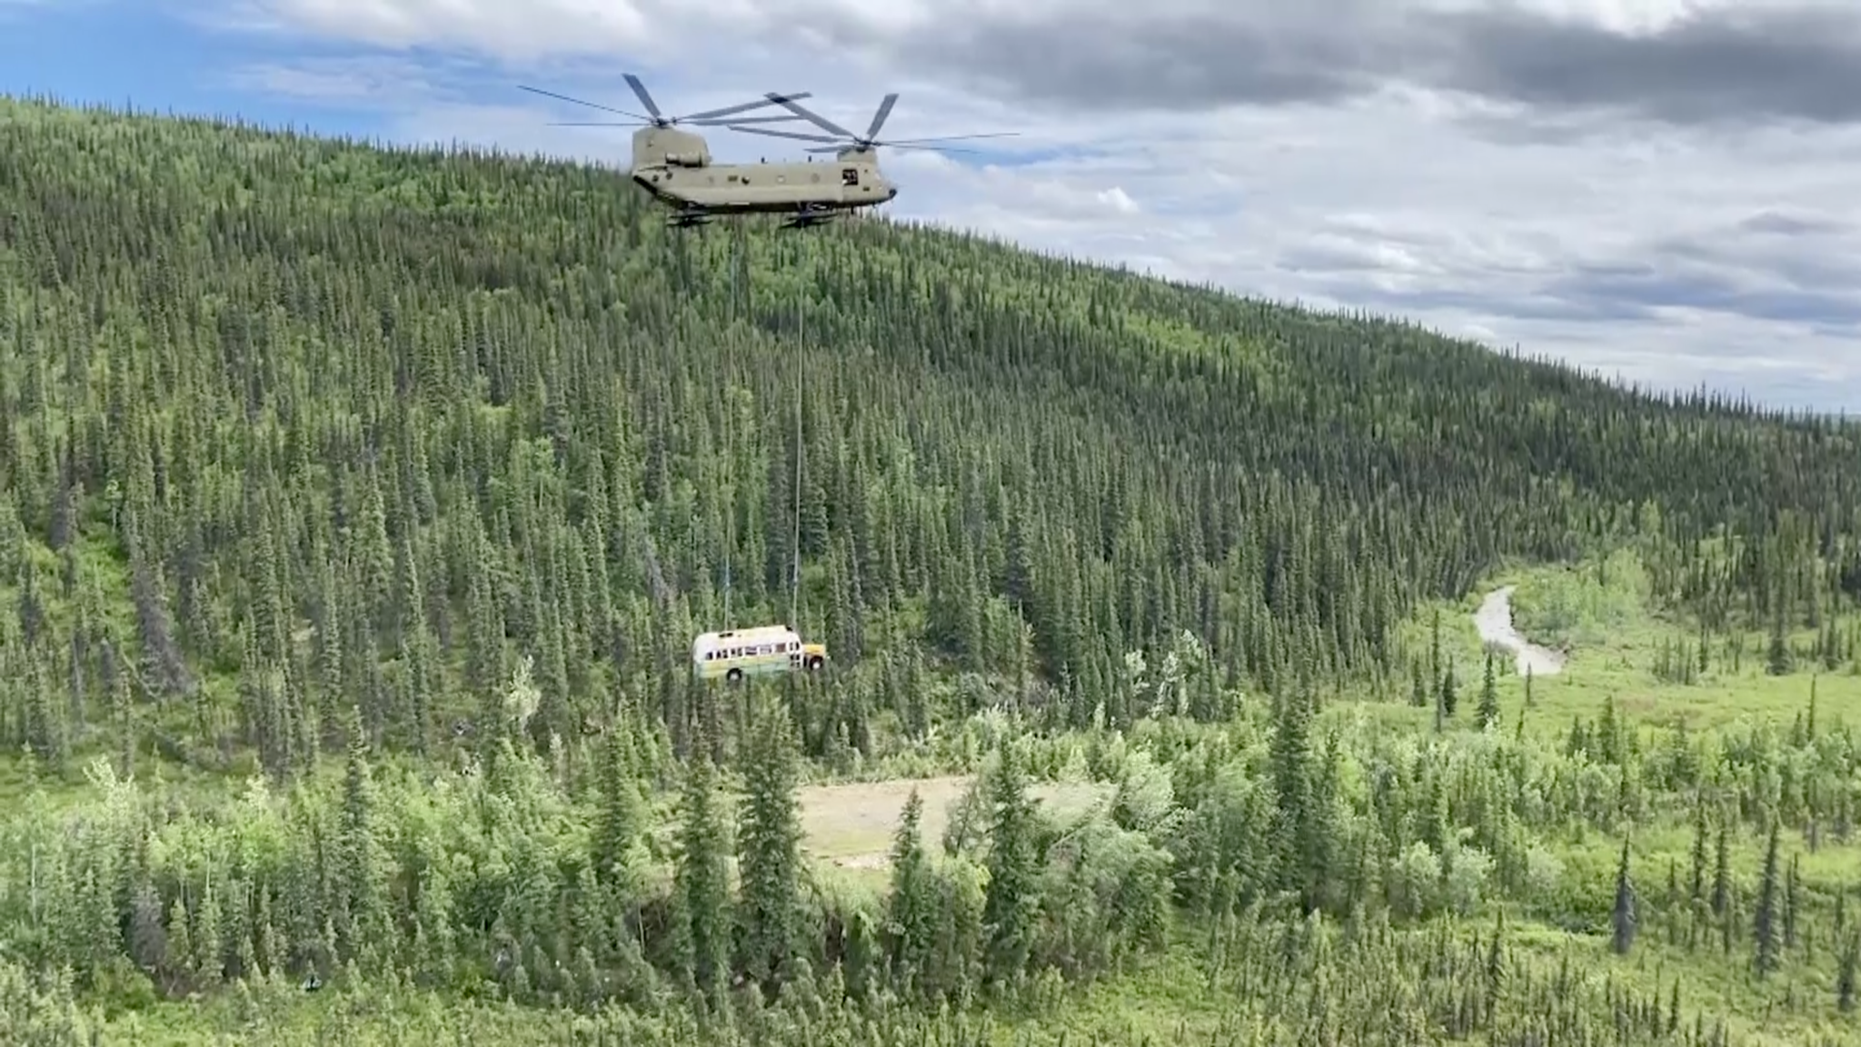
That’s it

